Slide 1

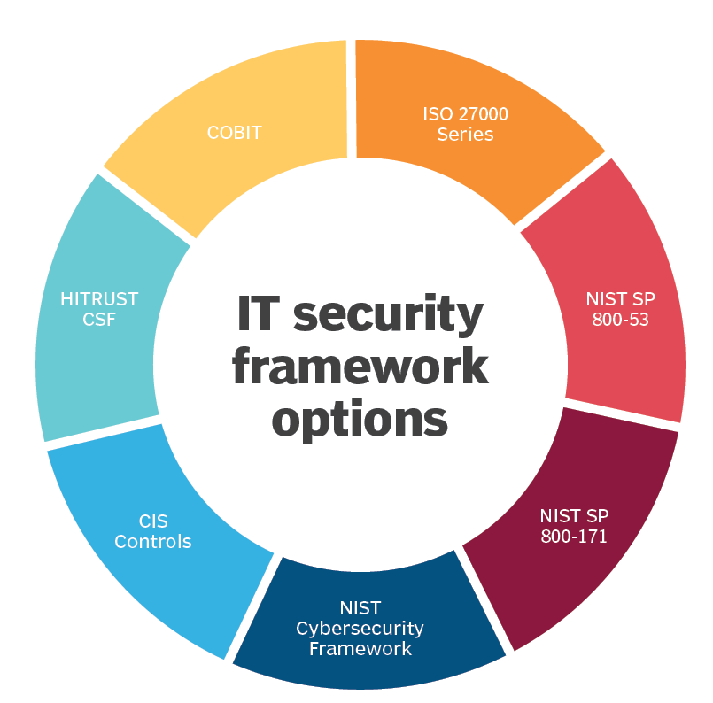
Security Frameworks

Slide 2
Security Frameworks
You hear the words “best practices” used a lot.
Security isn’t done the same way at every organization. Risk appetite, culture, needs, all dictate strategy and buy-in.
Security frameworks provide an objective basis in a field where subjective assessments are common.
Frameworks are developed by experts based on real-world performance. (Enhanced or validate security posture.)

Slide 3
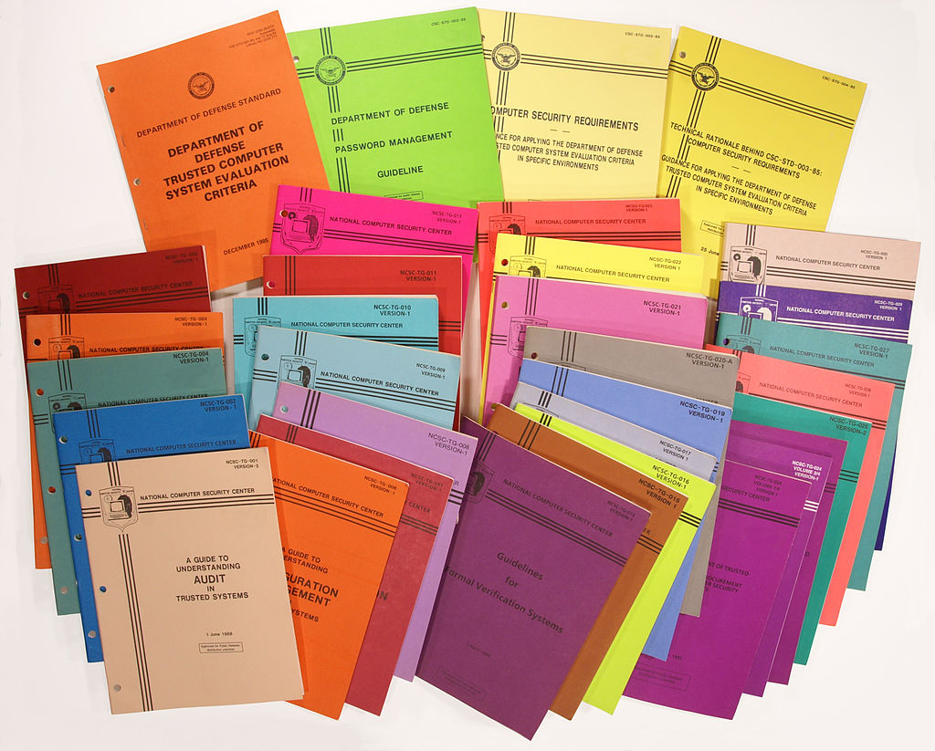
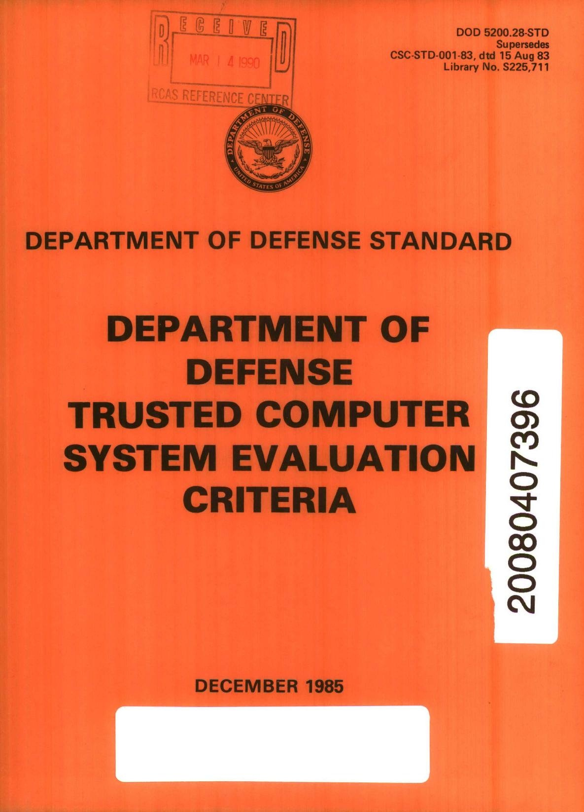
The Orange Book
Computer system security was not a thought during development and initial use. When the government (IRS, DoD, etc.) started using computer systems, it became apparent that standard security was required, and so in 1985 the Department of Defense Trusted Computer System Evaluation Criteria (TCSEC) was published – also known as the Orange Book.
It was part of the Rainbow Series – computer security standards issued with different colored covers.

Slide 4
TCSEC Divisions
The Orange Book provides different classifications of system with requirements that build on or modify requirements of lower tiers.
D – Minimal Protection
C – Discretionary Protection
B – Mandatory Protection
A – Verified Protection

Slide 5
TCSEC Divisions
The classification in TCSEC would place most commercial computer systems in a C1 or C2 division.
See the document itself for details on security standards.

Slide 6
Basic provisions for C level systems
You need to be able to identify users to access the system.
You need to be able to deny users without access.
You need to be able to set up trust relationships between users (subjects) and objects within the system.
Actions within the system are logged.
These logs are used to validate system security.

Slide 7
What is a Security Framework?
An information security framework is a series of documented, agreed and understood policies, procedures, and processes that define how information is managed in a business, to lower risk and vulnerability, and increase confidence in an ever-connected world.
Essentially, instead of having to develop standards and policies form scratch, there are broadly-applicable rules already written and updated by the industry.
They are also sometimes requirements for industry compliance standards.
The ones most commonly used are NIST, COBIT, ISO 27K

Slide 8
CIS – Critical Security Controls
The CIS Critical Security Controls are a recommended set of actions for cyber defense that provide specific and actionable ways to stop today's most pervasive and dangerous attacks.
A principal benefit of the Controls is that they prioritize and focus a smaller number of actions with high pay-off results.
The Controls are effective because they are derived from the most common attack patterns. A study of the controls showed that the basics alone would have prevents 85% of recent successful attacks.

Slide 9

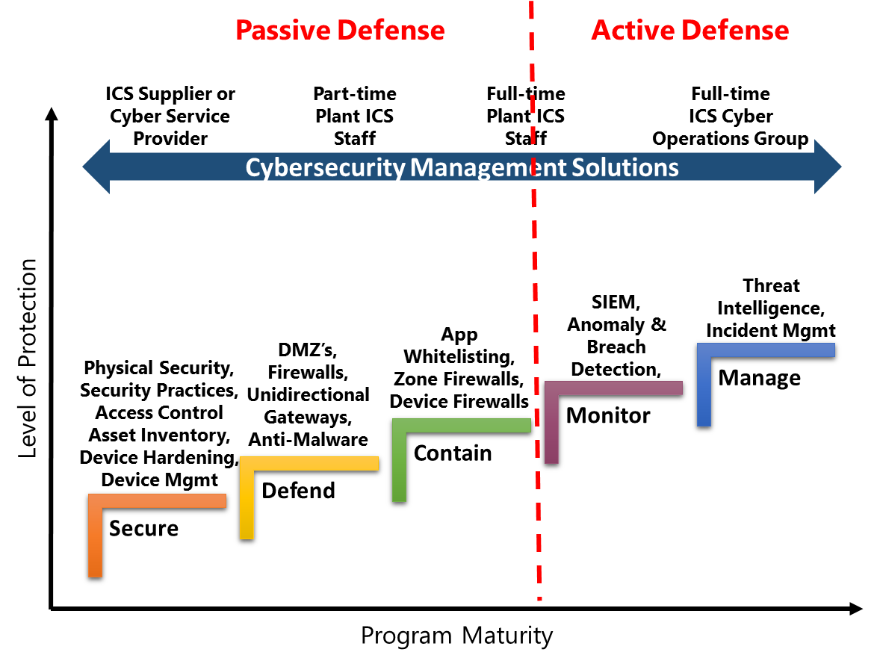

Slide 10
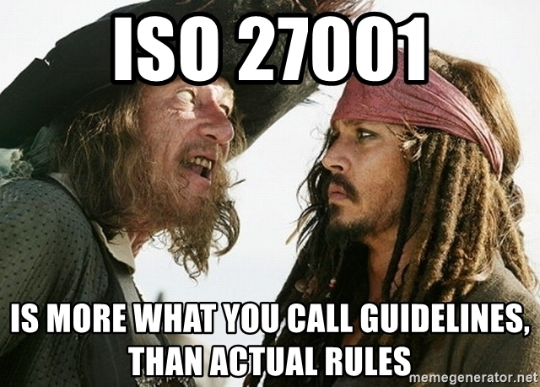

Slide 11
COBIT
Began as an audit standard and grew from there.
Contains some articles and conditions of using COBIT to implement NIST standards.
Very business-centric design.
Takes a top-down management-focused approach.

Slide 12
COBIT
COBIT - Control Objectives for Information and Related Technologies is a good-practice framework created by international professional association ISACA for information technology (IT) management and IT governance.
ISACA first released COBIT in 1996, originally as a set of control objectives to help the financial audit community better maneuver in IT-related environments. Seeing value in expanding the framework beyond just the auditing realm, ISACA released a broader version 2 in 1998 and expanded it even further by adding management guidelines in 2000's version 3. In April 2012, COBIT 5 was released, which is the current version.

Slide 13
ISO 27k
This is a series of publications defining IT security that are used mostly in the EU and associated economies.
ISO – International Standards Organization is an independent, non-governmental international organization with a membership of 160 national standards bodies.
Through its members, it brings together experts to share knowledge and develop voluntary, consensus-based, market relevant International Standards that support innovation and provide solutions to global challenges.

Slide 14
ISO 27k
The ISO story began in 1946 when delegates from 25 countries met at the Institute of Civil Engineers in London and decided to create a new international organization ‘to facilitate the international coordination and unification of industrial standards’.
On 23 February 1947 the new organization, ISO, officially began operations. Since then, they have published over 22218 International Standards covering almost all aspects of technology and manufacturing.
Information security standards can be found in publication 27001. Check D2L for a pdf digest, you’ll notice the full standard is not made available for free.

Slide 15
ISO 27k
27000 Overview, introduction and glossary of terms for the 27000 series
27001 Requirements standard for an ISMS
27002 Code of practice for 27001 standards
27003 Guidance on implementing 27001
27004 Guidance on measurements of the ISMS program, including suggested metrics
27005 Risk management
27006 Guide to the ISO27000 certification process
27007/008 Guide to auditing the ISMS program and controls

Slide 16
NIST
The NIST IT Security Framework is one of the most common. It’s used regularly in higher ed, government, and some business. Pretty much only the USA.
It’s free.
It’s effective.
It can be a lot of material to digest, but it is also very comprehensive. You can find a NIST standard for almost anything.

Slide 17
NIST SP 800
NIST – The National Institute of Standards in Technology. The National Institute of Standards and Technology is a metrology laboratory, and a non-regulatory agency of the United States Department of Commerce. Its mission is to promote innovation and industrial competitiveness.
They issue standards documents on many facets of technology in commerce. Ever since the early 90s they have issued standards on data security, and prior to that with standards in telecommunication, etc.
The bulk of information security standards is organized into Special Publication 800. There are additional publications that provide detailed guidelines for different aspects of security. 800.111 for example covers encryption of end user devices.

Slide 18
FIPS
Federal Information processing Standards
US Government specifications for security requirements.
https://csrc.nist.gov/publications/fips

Slide 19
Trustworthy Systems
What makes systems trustworthy?
Multiple attributes of trustworthiness include security, safety, reliability, etc.
Privacy must be considered one of the attributes
How can we know if systems are trustworthy?
Repeatable and measurable approaches help provide a sufficient base of evidence
Privacy needs a body of guidance for repeatable and measurable approaches similar to other attributes of trustworthiness

Slide 20
SP 800-37 / SP 800-53A
Continuous Monitoring
Starting Point
FIPS 200 / SP 800-53
CSC Control Tailoring
FIPS 199
MONITOR
Security Controls
CATEGORIZE Information System
SELECT Security Controls
Continuously track changes to the information system that may affect security controls and reassess control effectiveness
Define criticality /sensitivity of information system according to potential impact of loss
Select baseline (minimum) security controls to protect the information system; apply tailoring guidance as appropriate
SP 800-37
Risk Management
SP 800-53 / SP 800-30
Security Center Analysis
AUTHORIZE Information System
SUPPLEMENT Security Controls
Determine risk to agency operations, agency assets, or individuals and, if acceptable, authorize information system operation
Use risk assessment results to supplement the tailored security control baseline as needed to ensure adequate security and due diligence
SP 800-53A
Control Effectiveness Audit
SP 800-17
System Security Plan (SSP)
SP 800-70
CSC Controls Roll out
ASSESS
Security Controls
DOCUMENT Security Controls
IMPLEMENT Security Controls
Determine security control effectiveness (i.e., controls implemented correctly, operating as intended, meeting security requirements)
Document in the security plan, the security requirements for the information system and the security controls planned or in place
Implement security controls; apply security configuration settings

Slide 21
Laws, Regulations, Requirements, Organizational Goals, Objectives
General Organizational Policy
Management’s Security Statement
Functional Implementing Policies
Management’s Security Directives
Standards
Procedures
Baselines
Guidelines
Specific Hardware
& Software
Step-by-Step Instructions
Consistent Level of Security
Recommendations

Slide 22
Documentation Hierarchy
Policies
Broad overviews
Standards
Compulsory requirements
Baselines
Minimum level of security
Guidelines
Offers recommendations
Not compulsory
Procedures
Step-by-step how-to document
Notes:
They should not address specific individuals and should be separate entities based on need to know and the ability to update
Mandatory: policy, procedure, standard
Discretionary: guidelines and baselines
Policies: are broad overviews, while these are more specific with detailed information.
As a rule they address roles versus individuals. High level management directives-non specific. Policies should last 2-3 years. Do not be too specific in the wording of the policy. Avoid technical implementation details. Keep policies as short as possible. Provide references to identify supporting documents. Thoroughly review prior to publishing. Set up periodic policy reviews. Define policy exceptions.
Standards: compulsory requirements for HW, SW, technology and security controls; technical documents that define steps to meet the goals and direction defined by policy. MANDATORY. Low TCO of safeguards and support disaster recovery (use of industry standards make it easier to rebuild)
Baselines: minimum level of security that each system must meet; establishes a common foundational secure state upon which additional and more stringent security measures can be built. Discretionary. Uniform way of implementing a safeguard
Guidelines: offers recommendations on implementing Standards and Baselines; operational guides for both security professionals and users.
Procedures: detailed, step-by-step process documenting actions; helps standardize security across all systems; IE adding a user to a system; Instructions in support the polices, standards, baseline or guidelines. Are often mandatory.

Slide 23
Framework 7-Step Process
Step 1: Prioritize and Scope
Step 2: Orient
Step 3: Create a Current Profile
Step 4: Conduct a Risk Assessment
Step 5: Create a Target Profile
Step 6: Determine, Analyze, and Prioritize Gaps
Step 7: Implementation Action Plan

Slide 24
Profile Cybersecurity Framework Component
Ways to think about a Profile:
A customization of the Core for a given sector, subsector, or organization.
A fusion of business/mission logic and cybersecurity outcomes.
Identify
Protect
Detect
Respond
An alignment of cybersecurity requirements with operational methodologies.
A basis for assessment and expressing target state.
A decision support tool for cybersecurity risk management.
Recover

Slide 25
Senior Executives
Broad enterprise considerations
Abstracted risk vocabulary
Implementation/ Operations
Deep technical considerations
Highly specialized vocabulary
Specialists in Other Fields
Specific focus outside of cybersecurity
Specialized or no risk vocabulary

Slide 26
 | Function | Category | ID
What processes and assets need protection? | Identify | Asset Management | ID.AM
 |  | Business Environment | ID.BE
 |  | Governance | ID.GV
 |  | Risk Assessment | ID.RA
 |  | Risk Management Strategy | ID.RM
What safeguards are available? | Protect | Access Control | PR.AC
 |  | Awareness and Training | PR.AT
 |  | Data Security | PR.DS
 |  | Information Protection Processes & Procedures | PR.IP
 |  | Maintenance | PR.MA
 |  | Protective Technology | PR.PT
What techniques can identify incidents? | Detect | Anomalies and Events | DE.AE
 |  | Security Continuous Monitoring | DE.CM
 |  | Detection Processes | DE.DP
What techniques can contain impacts of incidents? | Respond | Response Planning | RS.RP
 |  | Communications | RS.CO
 |  | Analysis | RS.AN
 |  | Mitigation | RS.MI
 |  | Improvements | RS.IM
What techniques can restore capabilities? | Recover | Recovery Planning | RC.RP
 |  | Improvements | RC.IM
 |  | Communications | RC.CO

Slide 27
Function | Category | ID
Identify | Asset Management | ID.AM
 | Business Environment | ID.BE
 | Governance | ID.GV
 | Risk Assessment | ID.RA
 | Risk Management Strategy | ID.RM
Protect | Access Control | PR.AC
 | Awareness and Training | PR.AT
 | Data Security | PR.DS
 | Information Protection Processes & Procedures | PR.IP
 | Maintenance | PR.MA
 | Protective Technology | PR.PT
Detect | Anomalies and Events | DE.AE
 | Security Continuous Monitoring | DE.CM
 | Detection Processes | DE.DP
Respond | Response Planning | RS.RP
 | Communications | RS.CO
 | Analysis | RS.AN
 | Mitigation | RS.MI
 | Improvements | RS.IM
Recover | Recovery Planning | RC.RP
 | Improvements | RC.IM
 | Communications | RC.CO
Subcategory | Informative References
ID.BE-1: The organization’s role in the supply chain is identified and communicated | COBIT 5 APO08.04, APO08.05, APO10.03, APO10.04, APO10.05 ISO/IEC 27001:2013 A.15.1.3, A.15.2.1, A.15.2.2 NIST SP 800-53 Rev. 4 CP-2, SA-12
ID.BE-2: The organization’s place in critical infrastructure and its industry sector is identified and communicated | COBIT 5 APO02.06, APO03.01 NIST SP 800-53 Rev. 4 PM-8
ID.BE-3: Priorities for organizational mission, objectives, and activities are established and communicated | COBIT 5 APO02.01, APO02.06, APO03.01 ISA 62443-2-1:2009 4.2.2.1, 4.2.3.6 NIST SP 800-53 Rev. 4 PM-11, SA-14
ID.BE-4: Dependencies and critical functions for delivery of critical services are established | ISO/IEC 27001:2013 A.11.2.2, A.11.2.3, A.12.1.3 NIST SP 800-53 Rev. 4 CP-8, PE-9, PE-11, PM-8, SA-14
ID.BE-5: Resilience requirements to support delivery of critical services are established | COBIT 5 DSS04.02 ISO/IEC 27001:2013 A.11.1.4, A.17.1.1, A.17.1.2, A.17.2.1 NIST SP 800-53 Rev. 4 CP-2, CP-11, SA-14

Slide 28
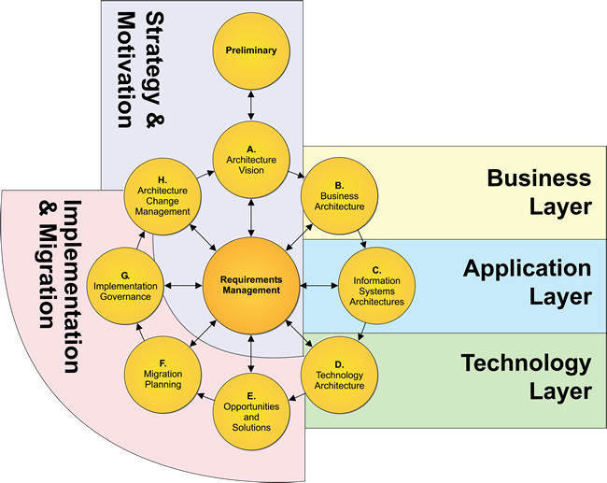

Slide 29
Building a Profile
1
Mission
Objective
A
B
C
Subcategory
1
2
3
…
98
Cybersecurity
Requirements
Legislation
Regulation
Internal & External Policy
Best Practice
Operating
Methodologies
Guidance and methodology on implementing,
managing, and
monitoring
2
3

Slide 30
Conceptual Profile
Cybersecurity Requirements | Subcategory | Priority | Operating Methodologies
A | 1 | moderate | I II
B C | 2 | high | III
D E | 3 | moderate | IV V
F | … | … | VI VII
G | 98 | moderate | VIII
2
1
3
When you organize yourself in this way:
Compliance reporting becomes a byproduct of running your security operation
Adding new security requirements is straightforward
Adding or changing operational methodology is non-intrusive to on-going operation

Slide 31
Resource and Budget Decision Making
As-Is
Year 1
To-Be
Year 2
To-Be
Sub- category | Priority | Gaps | Budget | Year 1 Activities | Year 2 Activities
1 | moderate | small | $$$ |  | X
2 | high | large | $$ | X
3 | moderate | medium | $ | X
… | … | … | …
98 | moderate | none | $$ |  | reassess
…and supports on-going operational decisions, too

Slide 32
Profile Ecosystem
TAXONOMY
REQUIREMENTS
PRIORITIES
1
2
3
...
98
1 | Req A
2 | Req B
3 | Req C
... | ...
98 | Req ZZ
1 | Req A | High
2 | Req B | Mod
3 | Req C | Low
... | ... | ...
98 | Req ZZ | High
NIST
Organization or Community
Community
Cybersecurity Framework Core
Crosswalks
Mappings
Cybersecurity Framework Profile

Slide 33
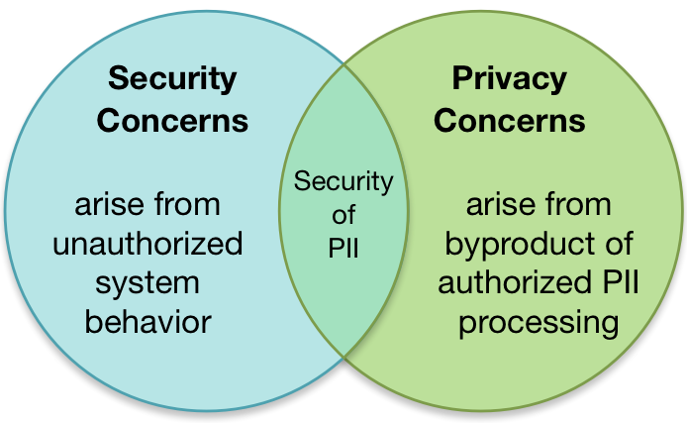
Information Security and Privacy: Boundaries and Overlap

Slide 34
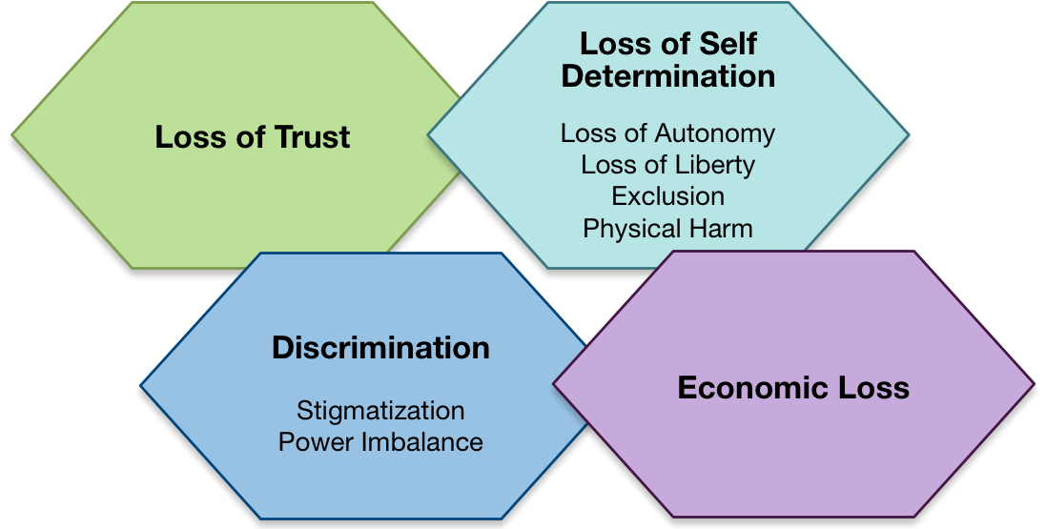
Processing PII Can Create Problems for Individuals

Slide 35
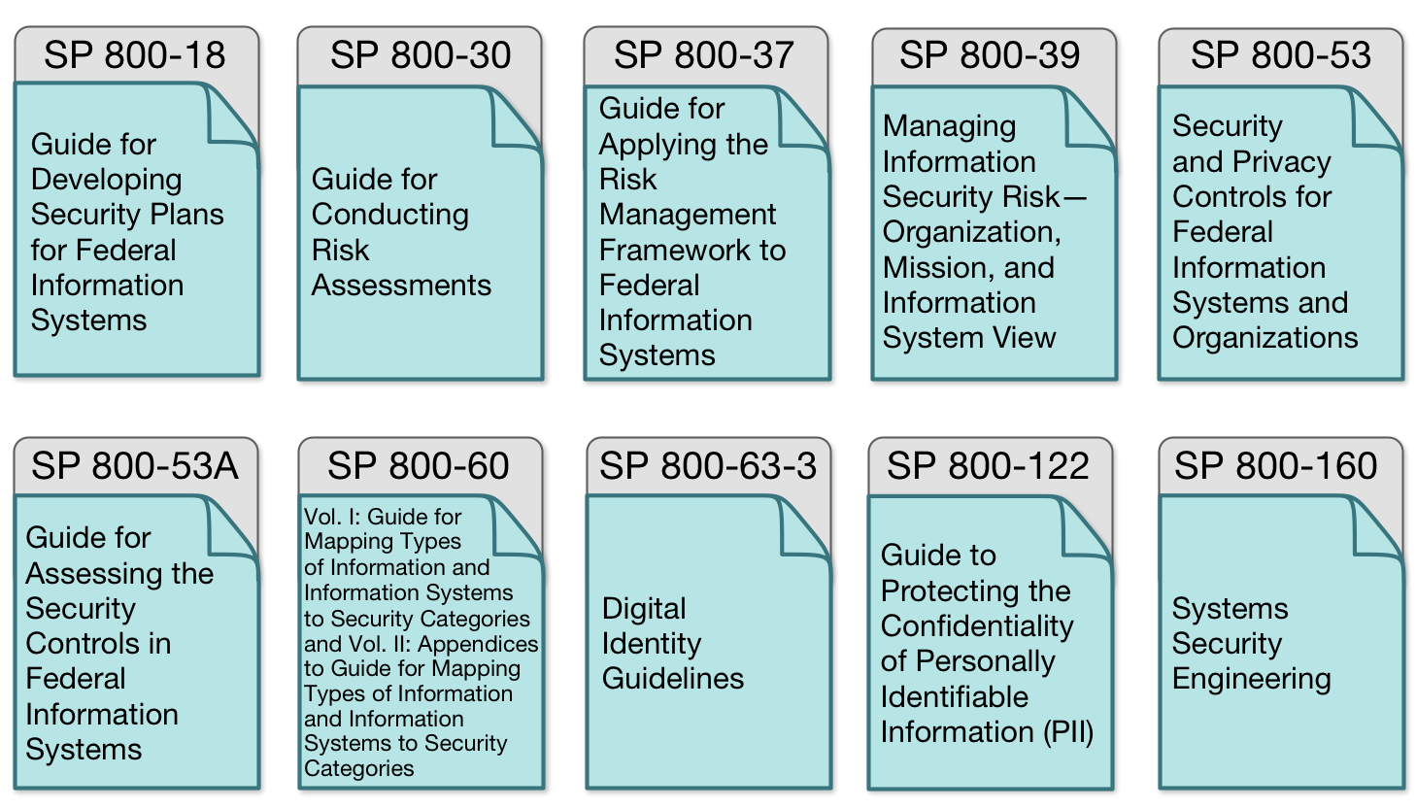
Guidance Roadmap

Slide 36
NIST Privacy Risk Assessment Methodology (PRAM)
Frame Org Privacy Governance
Assess System Design
Assess Privacy Risk
Select Privacy Controls
Monitor Change
Frame Business Objectives
Notes:
Introduce Jenn

Slide 37
Types of Data - PCI
Payment Card Industry standards govern the use and security of credit card data. Since the PCI Council is not a government entity, their Data Security Standards (DSS) are a contractual obligation, rather than a legal requirement.
It is still critical to maintain compliance as the ramifications are huge (aside from a breach) – the organization losing their ability to accept credit cards because issuers have blacklisted them, for example. That’s kind of a big deal for ecommerce or retail organizations.
Data Security Standards are in a constant state of review. Revisions are released periodically and become mandatory on a timeframe. We’re currently (as of Feb 2018) mandated to comply with PCI DSS 3.2

Slide 38


Types of Data - PCI
Responsible for managing the PCI DSS and certifying QSAs and ASVs
Responsible for enforcing and monitoring merchant compliance with the PCI DSS
CREDIT CARD SECURITY
Bank
Merchant
Communicates and educates merchants on PCI DSS and reports compliance status to Card Associations
Responsible for safeguarding credit card data and complying with the PCI DSS
Multiple people play a role in the PCI process because PCI is a contract between the Merchant (the person accepting credit cards), the Issuer (credit card companies), an Acquiring Bank (the bank performing the transactions), and the PCI Council (the governing body over standards.)

Slide 39
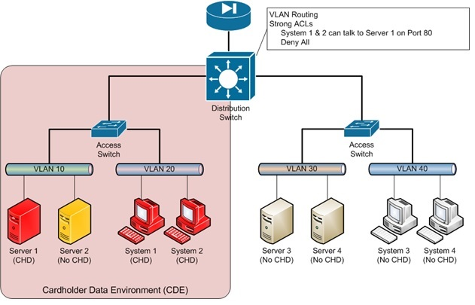

Slide 40
Types of Data - PCI
Anyone that takes plastic in any form must be in compliance with the standards. Any system that stores, processes, or transmits card data is in scope and must comply with current DSS.
Sometimes, in the course of an audit, it will be discovered that card data is being sent over an unknown system (“Oh, btw, did you know Tina in Sales is taking credit cards over the phone?”) – when that happens, it “pulls” the entire system “in scope.” Now the ENTIRE phone system must be PCI compliant (Tina’s phone and everything it connects to.)

Slide 41
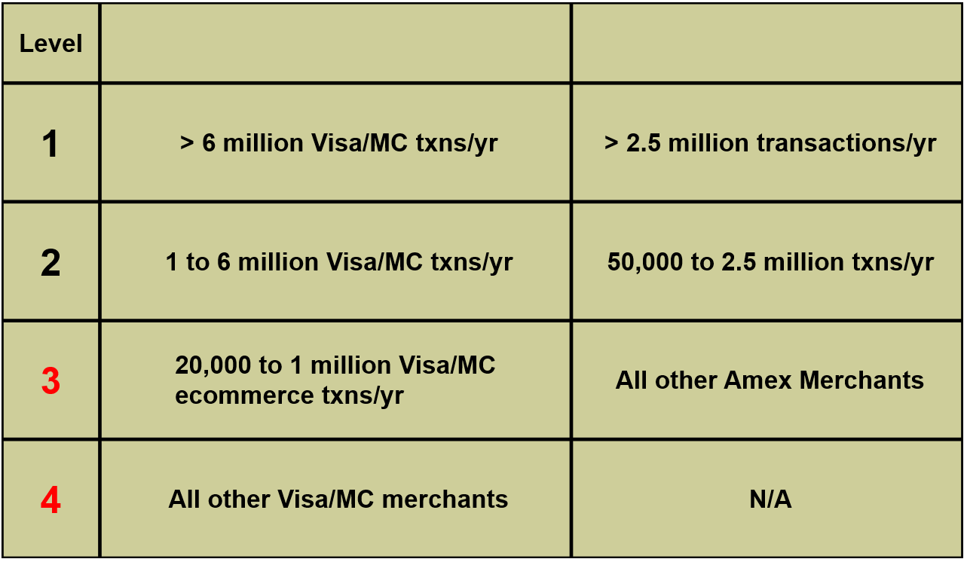
Types of Data - PCI
The number of transactions a merchant takes determines their level.

Slide 42
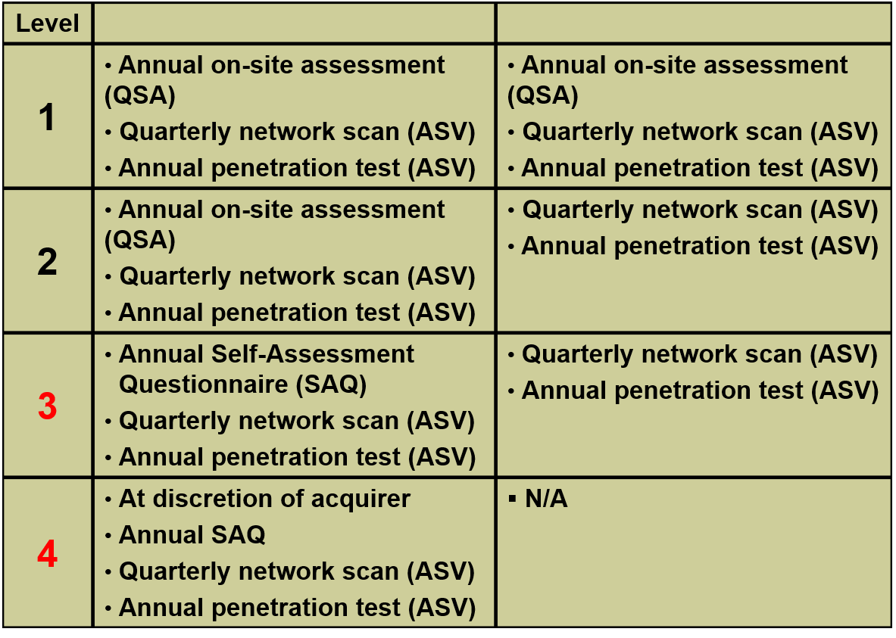
Types of Data - PCI
The merchant’s level determines what types of audits they face.

Slide 43
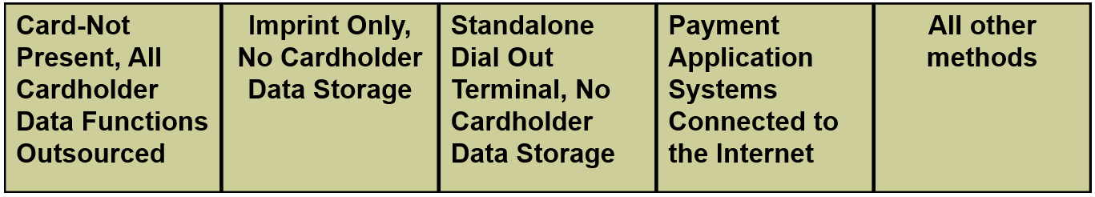
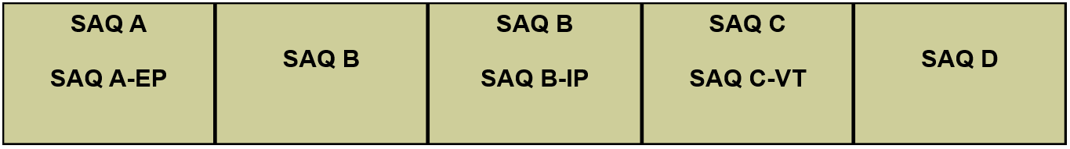
Types of Data - PCI
The Self-Assessment Questionnaire is a form that describes various controls. The merchant marks down whether or not they comply with the standard, and are audited against that. For example, the SAQ may contain the following provision: “All authentication utilizes passwords of at least 7 characters.” The potential options are Yes, No, or N/A. There is no “maybe” “sometimes” or “I don’t know”
There are multiple types of SAQs. The SAQ D described roughly 330 controls to comply. The SAQ B, about 40.

Slide 44
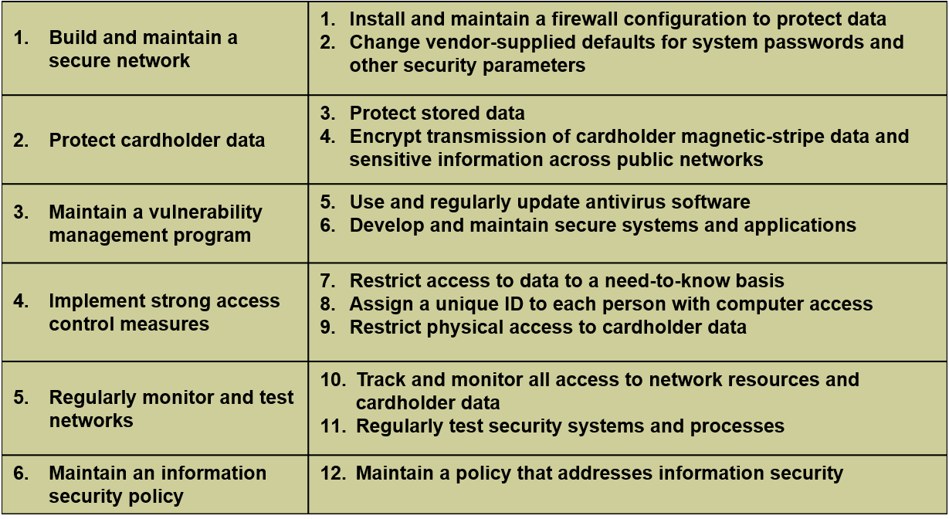
Types of Data - PCI
The PCI DSS is full of a lot of controls. However, the basic six objectives have been around since DSS 1.0 with the accompanying twelve goals.

Slide 45
